Slide 1


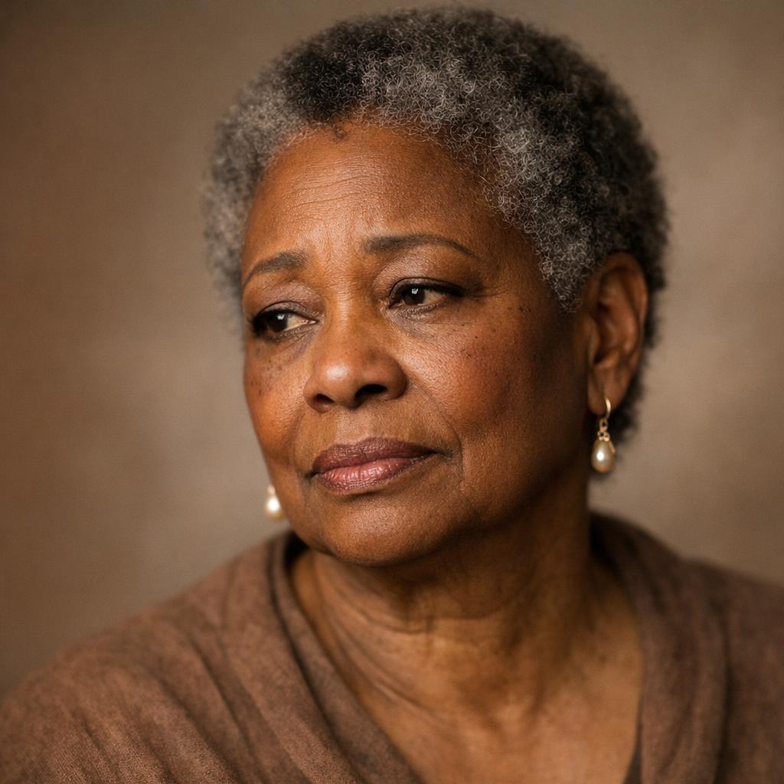
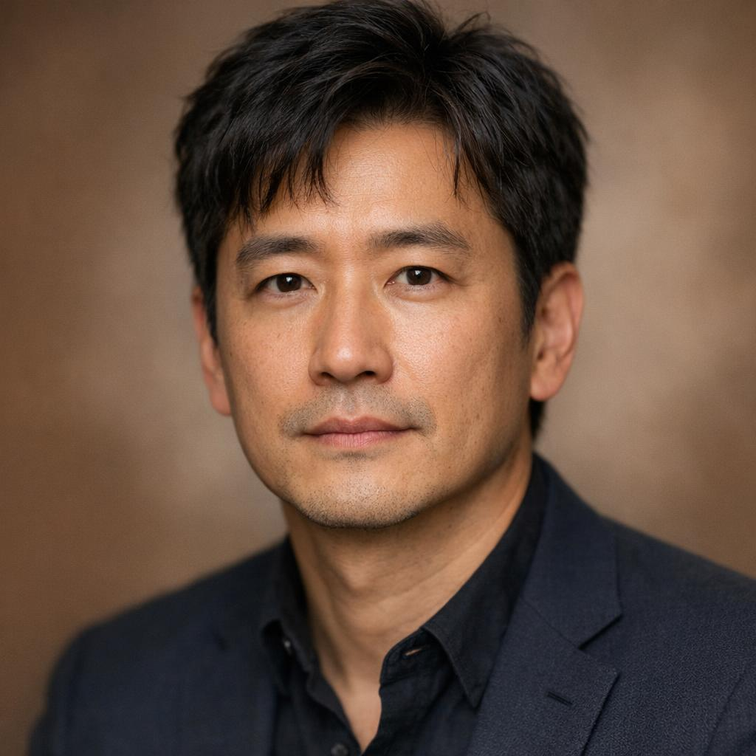
The Many Faces
of Grief
And why they matter to the
Beginning Experience® Process

Slide 2
The Five Stages of Loss
Elisabeth Kübler-Ross, 1969
1
2
3
4
5
Denial
Anger
Bargaining
Depression
Acceptance
A defense mechanism that buffers the immediate shock of loss
Frustration surfaces as the reality of the loss begins to set in
Dwelling on "what if" and "if only" to regain control
Deep sadness as the full weight of the loss is felt
Coming to terms with the reality and finding a way forward
Notes:
Since Beginning Experience® facilitators are familiar with the Five Stages of Grief (or Loss, as K-R originally called them), we won’t spend time on these, but I will take questions later.
Experiencing these stages (and others) can be traumatic AND transformative.

Slide 3
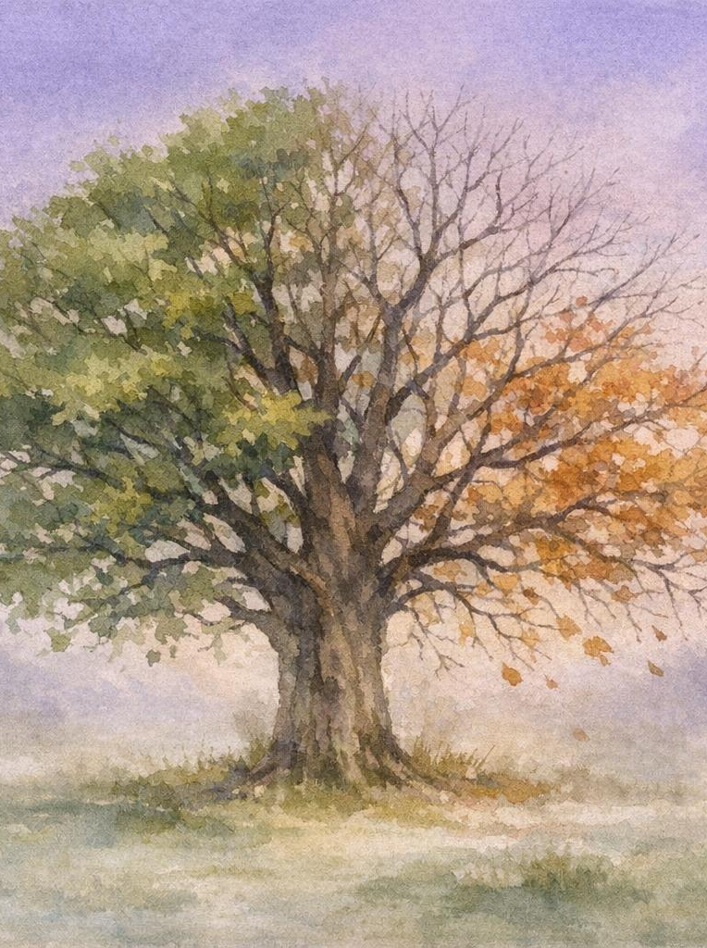
What Is Grief?
Grief is the natural response to loss — a deeply personal experience that touches every part of who we are. It is what’s going on inside of us in contrast with “mourning” which is what we do on the outside. (adapted from David Kessler)
Emotional Sadness, anger, guilt, anxiety, and longing
Physical Fatigue, changes in appetite, and sleep disruption
Cognitive Difficulty concentrating, disbelief, and confusion
Social Withdrawal, changes in relationships, and isolation
Notes:
When was the last time we thought about this definition as opposed to going through the steps of the Weekend or other programs?
Per John Bradshaw, the deepest core feeling of grief is TOXIC SHAME which leads to LONELINESS

Slide 4
What We Know About Grief
Grief is not linear
It’s not a broken head, it’s a broken heart
We are not licensed counselors, but…
We have unique perspectives as peers-in-grief
Connections are healing for us and our participants
Notes:
When I say “what we know,” I think back to Sr. Josephine who, as a professional counselor, knew how to capitalize on the aspects of grief and their effects on humans; thus was born the methodology of Beginning Experience® Ministry.
Per John Bradshaw, the deepest core feeling of grief is TOXIC SHAME which leads to LONELINESS

Slide 5
Timeline of Grief
Everyone’s timeline on their grief journey is different, so these are just a guideline for reference
Anticipatory
Acute
Before a loss, e.g., during a terminal illness or in a rocky relationship
The intense, immediate response to fresh loss
Early
Mature
The first two years
Grief that lasts the rest of one’s life
Year 1
Year 2
Year 3
Year 4
Year 5
Notes:
See: John Bradshaw, author of Home Coming: Reclaiming and Championing Your Inner Child,

Slide 6
Types of Grief
Grief wears many faces — recognizing its forms helps us respond with compassion.
Traumatic
Collective (Public)
Combines trauma with bereavement or grief responses; all trauma has grief but not all grief has trauma
Shared grief experienced by a community after events like natural disasters or public tragedies
Disenfranchised
Grief that is not openly acknowledged or socially supported — e.g., estrangement, miscarriage, divorce, suicide, or loss of a pet
Prolonged (Complicated)
Prolonged, intense grief that interferes with daily functioning for an extended period
Notes:
Disenfranchised: the griever may do it to himself, feeling shame or thinking he has no right to grieve. Can lead to “complicated” grief.
Others:
Authority wounds – caused by (adult) who abused their power in our youth or by systemic oppression.
Delayed – when we do not grieve at the time of loss (due to perceived or real constraints)
Inconclusive – no body to grieve, but there is hope -> spawns conspiracy theories
Ambiguous – grief that is hard to see
See: John Bradshaw, author of Home Coming: Reclaiming and Championing Your Inner Child and David Kessler’s Grief Educator, Lesson 1

Slide 7
Accompaniment
DO
DON’T
Be curious, try to understand
Listen with the heart
Sit in sacred silence
Be fully present
Meet the griever where s/he is
Respect the griever, their disorder and confusion
Encourage “feeling” responses
Attempt to Fix – no one is broken
Try to make the pain of loss disappear
Act as a leader – we walk together
Teach / Preach / Advise
Push for resolution – each journey is unique
Encourage “head” responses
Focus on your story
Notes:
How Team Benefits
--Allow yourself to benefit from the above
--We are supported by other team members in our journey
--We learn empathy
How Participants Benefit
--they may feel seen for the first time since their loss
--recognize they are not the “only one”
--find hope in the stories and love of team members

Slide 8

Coping with Grief
Allow participants to feel
There's no right way to grieve. Give yourself and others permission to experience whatever emotions arise.
Seek connection
Share stories in small group and with friends or family. No one has to carry grief alone.
Take care of the body
Rest, nourish the body, and move gently. Physical care supports emotional healing.
Create rituals of remembrance
Honor the loss through meaningful practices — journaling, a memory box, or a dedicated space.
Be patient with yourself and others
Healing is not linear. Some days will be harder than others, and that's okay.
Notes:
These coping suggestions apply to both participants AND team members

Slide 9

Healing from Grief
We heal when we can remember what we have lost with more love than pain, when we find a way to create meaning in our own life in honor of who/what was lost.
(adapted from David Kessler)

Slide 10

You Are Not Alone
Grief is the price we pay for love — and there is no timeline for healing.
Reach out. Be gentle with yourself. Let others in.
GriefShare – griefshare.org; DivorceCare – divorcecare.org
Letting Go: The Way Into Abundance – Sr. Josephine Stewart
On Grief and Grieving – Elisabeth Kubler-Ross and David Kessler
David Kessler – grief.com
Dr. Alan Wolfelt – centerforloss.com
Resources
Notes:
These are the messages we want to convey; not necessarily verbally, but through our actions in every program we offer.

Slide 11
Michelle Barrentine, Certified Grief Educator
Beginning Experience of San Antonio
mitchtez@yahoo.com
210-215-3733

