Slide 1

Boundaries in Ministry
Caring Without Losing Yourself
Beginning Experience International Convention 2026
Notes:
Talking Points:
Welcome.
Introduce yourself briefly.
Mention your roles as therapist, BE minister, and fellow traveler.
Today isn't about creating distance from those we serve. It's about learning how to remain available for ministry for years to come.

Slide 2
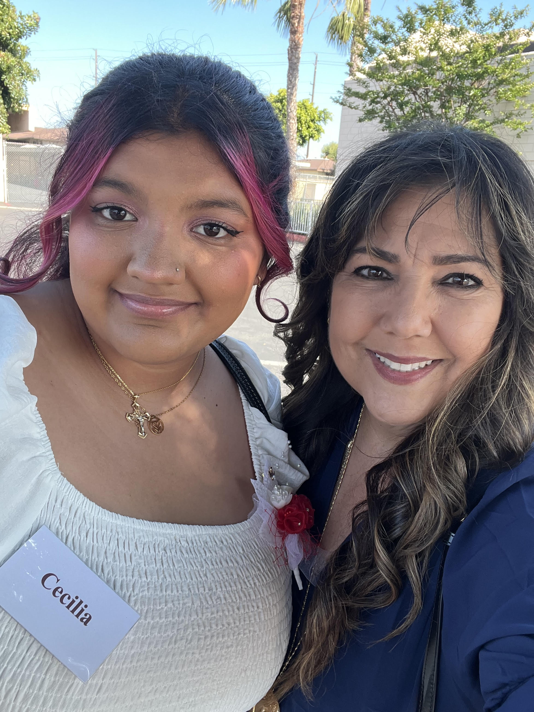
About Me
Ingrid E. Mürrle
LMFT
Beginning Experience participant (2019)
BE-OC Facilitator & Leader
BEI Program Committee Chair
Notes:
Talking Points:
I wear a few different hats that have shaped today's presentation.
Professionally, I'm a Marriage and Family Therapist and have spent over 30 years working with trauma, grief, and healing.
Personally, I came to Beginning Experience during a season of profound loss and transition.
Like many of you, I've experienced both sides of ministry—receiving support and offering it.
Over the years I've learned that caring for others is sacred work, but I've also learned that if we don't care for ourselves, eventually we have nothing left to give.
Today's workshop is really about how we remain compassionate without becoming overwhelmed, and how we continue serving for years—not just weekends.

Slide 3

Opening Reflection
Why Did You Say Yes to Ministry?
Activity:
Turn to someone nearby.
Discuss:
What first drew you to BE ministry?
What keeps you coming back?
Notes:
Talking Points:
Activity: Ask for a few responses.
Examples-
Someone helped me.
I wanted to give back.
It changed my life.
I don't want others to be alone.
Most of us said yes because someone walked beside us.
Most of us came to this ministry because we care deeply.
And that's exactly what makes this work so beautiful.
It's also what makes us vulnerable.
Compassion is our strength.
Compassion without boundaries can become depletion.

Slide 4
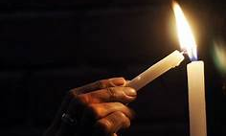
The Ministry Paradox
The More We Care, The More Vulnerable We Become
Notes:
Talking Points:
Many of us entered ministry because someone carried a light for us when life felt dark.
Grief ministry is sacred work.
We hear painful stories.
We witness suffering.
We often identify with participants.
The paradox is that the very thing that makes us effective ministers—our compassion—can also place us at risk.
Compassion Fatigue
Compassion fatigue is the emotional and physical exhaustion that can come from caring deeply for people who are suffering.
Examples:
Feeling drained
Feeling depleted
Wanting to withdraw
Secondary Traumatic Stress
Sometimes we hear so many painful stories that we begin carrying pieces of them ourselves.
Examples:
Thinking about participants after weekends
Difficulty letting go
Strong emotional reactions
You can normalize:
This doesn't mean you're doing ministry wrong. It means you're human.
Burnout
Burnout tends to develop more gradually.
Examples:
Cynicism
Irritability
Loss of joy
Feeling disconnected from purpose
Ask:
Has anyone ever experienced one of these? Even briefly?
Quick show of hands
The goal isn't to care less.
The goal is to care in a way that allows us to continue serving.
That line is worth putting in your speaker notes.

Slide 5
Boundaries Are Not Walls
Isolation
Healthy Connection
Over-involvement
Detached
Avoiding
Unavailable
Present
Compassionate
Boundaried
Rescuing
Fixing
Taking Responsibility
Notes:
Talking Points:
When people hear the word boundaries, they often think of walls.
- many of us imagine distance, separation, or shutting people out.
But healthy boundaries aren't walls—they're bridges.
- not about moving away from people—they are about staying connected in a sustainable way.
Too much distance can leave people feeling unseen or unsupported.
But too much involvement can leave us carrying burdens that were never ours to carry.
ASK:
When you're stressed or emotionally invested, which direction do you tend to drift—toward distance or toward carrying too much?
Isolation
When we're here, we become disconnected.
We may avoid difficult conversations or emotionally withdraw.
Healthy Connection
This is where ministry happens.
Healthy ministry happens in the middle.
We are present, compassionate, and connected but we do not lose ourselves in someone else's journey.
- We remain aware that another person's healing journey belongs to them.
Over-Involvement
This is where many of us drift.
Especially in grief ministry.
We begin:
Fixing
Advising
Worrying
Carrying
We start believing that if we care enough, we can control the outcome.
But that's a burden none of us were ever meant to carry.
Many of us entered ministry because someone helped carry us for a time.
The challenge is remembering that helping someone stand again is different from carrying them forever.
Our role is not to be the Savior.
That position is already filled.
Our role is to accompany.

Slide 6
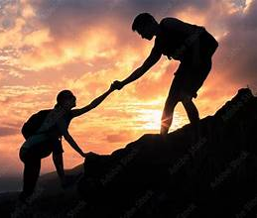
When Boundaries Get Blurred
Most Boundary Challenges Begin With Good Intentions
Notes:
Talking Points:
Most blurred boundaries don't begin because we care too little.
They begin because we care deeply.
We want to help. We remember our own pain. We don't want someone to feel alone.
The question isn't whether we care.
The question is whether our caring remains healthy and sustainable.

Slide 7
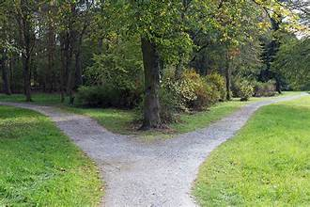
Healthy Connection or Boundary Drift?
You find yourself thinking about a participant every day and worrying about them constantly.
A participant calls frequently and you feel guilty if you don't answer immediately.
You feel hurt when a participant ignores your advice.
A participant's story closely mirrors your own loss, and you become especially invested.
Notes:
Discussion Questions:
What might be happening?
What feelings come up?
What might help?
Give own examples:
I remember finding myself thinking about someone long after an event had ended...
- the one participant we rallied and took to dinner & spent endless amount of time on the phone
- the participant who struggled sitting in reflection and wanted to talk privately throughout the entire reconciliation time on Saturday night
- teach to fish – sitting with a participant to walk through her steps for a community appeal

Slide 8

Caring vs Carrying
CARING | CARRYING
Walking Beside | Pulling Along
Listening | Fixing
Supporting | Rescuing
Encouraging | Directing
Trusting God | Taking Responsibility
Present | Over-invested
Notes:
Talking Points:
Many of us entered ministry because someone walked beside us.
The invitation is not to carry someone else's grief.
The invitation is to accompany them while trusting God with what belongs to God.
If you only remember one slide from today, let it be this one.
Ask:
Where do you most often find yourself drifting?

Slide 9
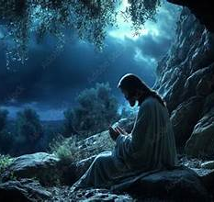
Even Jesus Had Boundaries
Jesus withdrew to pray.
Jesus rested.
Jesus did not meet every need.
Jesus trusted the Father with outcomes.
Boundaries are an act of trust—
trust that God's work continues even when we step back to rest, pray, and renew.
Notes:
Talking Points:
Many of us hold ourselves to incredibly high standards in ministry.
We want to be available. We want to help.
We want to make a difference. We don't want anyone to feel as alone as we once felt.
Yet throughout Scripture, we repeatedly see Jesus stepping away from the crowds.
He withdrew to pray.
He rested.
He sought solitude.
He renewed Himself.
There were always more people who wanted His attention.
More needs. More suffering. More people who were hurting.
Yet Jesus did not meet every need, heal every person, or remain available every moment of every day.
Instead,
He remained faithful to His mission while trusting the Father with what was beyond His responsibility.
Transition to Ministry
One of the hardest parts of grief ministry is sitting with someone who is hurting and knowing we cannot fix it.
We cannot make their grief go away.
We cannot heal them on our timeline.
We cannot carry their journey for them.
And if we're honest, sometimes that's uncomfortable.
Sometimes rescuing feels easier than witnessing pain.
Sometimes taking responsibility feels easier than surrendering control.
Permission
What Jesus models for us is something many ministers struggle to give themselves permission to do.
He models rest.
He models limits.
He models stepping away to reconnect with God.
He models trusting that God's work can continue even when He is not actively doing the work Himself.
Key Takeaway
Healthy limits are not a sign of weakness.
They are a recognition of our humanity.
Boundaries are not what get in the way of ministry.
They are what make ministry sustainable.
Closing Reflection Question
Jesus trusted that God's work could continue even when He stepped away to pray, rest, and renew.
Do we trust that too?
Boundaries are an act of trust—trust that God's work continues even when we step back to rest, pray, and renew.

Slide 10

What Happens When We Carry Too Much?
Above the Surface
Fatigue
Irritability
Withdrawal
Frustration
              Below the Surface
              Unprocessed grief
              Triggers
              Fear
              Guilt
              Responsibility
              Over-identification
Notes:
Talking Points:
Most people notice the symptoms.
The real work is underneath.
Important!
The participant's story may not be what is overwhelming us.
Sometimes it is the way their story touches our own.

Slide 11

Signs of Emotional Overload
Thinking about participants constantly
Trouble sleeping
Feeling responsible
Emotional exhaustion
Increased irritability
Difficulty letting go
Spiritual Warning Signs
Losing joy
Feeling obligated
Resenting ministry
Feeling like everything depends on me
Notes:
Talking Points:
This doesn't mean you're doing ministry wrong.
It means you're human.

Slide 12

Staying Centered
One Foot in Their Story
One Foot in Your Own Groundedness
Notes:
Talking Points:
When someone is hurting, we need one foot in their experience.
But we also need one foot firmly planted in our own groundedness.
If we lose compassion, we become detached.
If we lose centeredness, we become overwhelmed.
Brief breathing or grounding exercise.
Centering Exercise (2 Minutes)
Talking Points:
I'd like to invite us to practice something together.
If you're comfortable, place both feet flat on the floor.
Pause.
Notice the support of the chair beneath you.
Pause.
Notice your feet making contact with the ground.
Pause.
You don't have to change anything. Just notice.
Pause.
Take a slow breath in.
Pause.
And a slow breath out.
Pause.
Again.
Pause.
As you breathe, notice three things that are supporting you right now.
Examples:
The chair
The floor
The people around you
Your faith
Your breath
Pause.
Notice that you can be fully present in this room without carrying everything in it.
Pause.
You can care deeply without taking responsibility for everything.
Pause.
You can be connected without becoming overwhelmed.
Pause.
Take one final breath.
Pause.
And when you're ready, bring your attention back to the room.
Debrief - Ask:
What did you notice?
Examples-
My shoulders dropped.
I slowed down.
I realized how tense I was.
I felt calmer.
Tie it to ministry:
This is what centeredness looks like.
Not detached. Not overwhelmed.
Present and grounded.
As you sit here, remember:
There is a difference between being present and taking responsibility.
There is a difference between caring and carrying.
There is a difference between accompanying someone and becoming responsible for their journey.

Slide 13
What Is Actually Mine To Carry?
Circle of Control
Not My Responsibility
My Responsibility
Choices
Healing timeline
Reactions
Outcomes
Whether they return
Listening
Compassion
Presence
Prayer
Referrals
Boundaries
Notes:
Talking Points:
Sometimes we carry things that belong to other people.
Sometimes we carry things that belong to God.
Neither is sustainable.
Ask:
Which item in the outer circle is hardest for you to let go of?

Slide 14

Sustaining Ministry
From Self-Care to Compassion Satisfaction
Roots
    Prayer
    Community
    Friendship
    Rest
    Purpose
    Joy
Self-care helps us recover. Compassion satisfaction helps us remain.
Notes:
Talking Points:
The goal isn't simply avoiding burnout.
The goal is remaining nourished.
What replenishes you spiritually after a weekend?
?Responses?

Slide 15

What Do I Need Permission To Do?
Notes:
Activity:
Hand participants an index card.
Prompt:
To sustain my ministry, I give myself permission to...
Examples:
Rest
Say no
Ask for help
Let go
Trust God
Allow quiet reflection.
Ask:
Would anyone be willing to share?

Slide 16
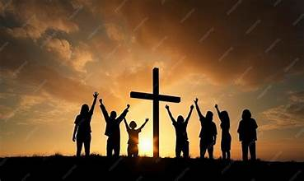
Final reflection
What burden do I need to set down?
"My role is not to carry another person's grief. My role is to walk beside them while trusting God to carry what neither of us can.“
– Ingrid E. Mürrle

Slide 17
Closing Prayer
Lord,
Help me to be present without becoming overwhelmed.
Help me to listen without taking ownership.
Help me to offer hope without demanding outcomes.
Help me to trust that You are already at work in the lives of those I serve.
Teach me to care deeply,
and to remember that I was never asked to carry alone.
Amen.

Slide 18

Thank You
Thank you for your ministry, your compassion, and your willingness to walk alongside others in their grief and healing.
May you continue to serve with hope, wisdom, healthy boundaries, and trust in God's work.
~ Ingrid E. Mürrle, LMFT
Beginning Experience International Program Committee Chair
Email: ingridmurrle@gmail.com

