Slide 1

BUILDING HAPPINESS
Beginning Experience Regional Conference 2015
Maura Heaney & Sandra Cromey
With thanks to Lise Desrochers, Winnipeg

Slide 2

Building Happiness
Tools and Design
Facilitator manual – Manual for programme Presentation
Workbook for Participants
10 week programme - 2 hour sessions
    Large group welcome, scripture reading and prayer
    Large group topic reading
    Play song/music related to the session’s topic
    Personal time – answering questions
    Small group discussion
    Closing prayer
Weekly Beginning Experience programmeme

Slide 3
Building Happiness
Topics
  Stress & Relaxation
  Self Acceptance
  Boundaries
  Feelings and Happiness
  Enjoying a Balanced Life
Weekly Beginning Experience programme

Slide 4
Building Happiness
Topics
  Committing to Growth, Not Perfection
  Communication
  Happiness and Spirituality
  Describing Happy People
  Celebrating Our Happiness (Laughter)
Weekly Beginning Experience programme

Slide 5

Building Happiness
Week 1
Stress & Relaxation
This session is to help you become aware that:
  Stress is responsible for many physical, emotional and behavioural changes in you
  Help you identify stressors and symptoms of stress in you life
  Help you find ways of coping with them
Weekly Beginning Experience programme

Slide 6

Building Happiness
Week 2
Self-Acceptance
This session is to get you in touch with your vision of yourself:
  Identify and accept your qualities and strengths
  Identify and accept your struggles, limitations and foibles.
  Explore and accept the positive and negative messages you have received from others which have formed the attitudes and beliefs you have of yourself today.
Weekly Beginning Experience programme

Slide 7
Building Happiness
Week 2
Self-Acceptance
At the end of this session, you can suggest that participants take an optional ‘personality self-test’ at home – for their own interest.
Available on the internet:
www.humanmetrics.com/cgi-win/jtypes2.asp
Look for heading “Jung Typology Test” – 72 items
Weekly Beginning Experience programme

Slide 8
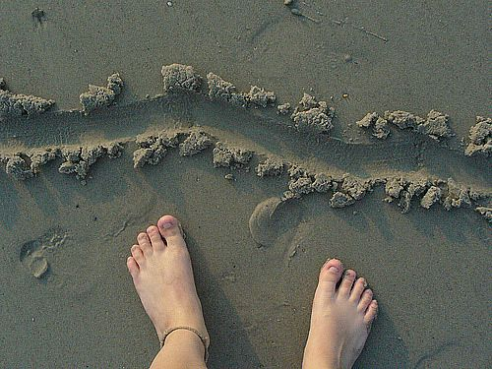
Building Happiness
Week 3
Boundaries
The purpose of this session is to learn about:
  Healthy and unhealthy boundaries
    Look at signs of healthy boundaries and examples of boundary violations
  Examine ways to set boundaries
    10 ways to build and preserve better boundaries
Weekly Beginning Experience programme

Slide 9

Building Happiness
Week 4
Feelings and Happiness
The purpose of this session is to:
  Help identify and let go of feelings that keep us from being in control of our happiness
  Achieving a balance between feeling and thinking (heart and mind)
  Explore 2 challenging emotions:
    Guilt
    Anger
Weekly Beginning Experience programme

Slide 10

Building Happiness
Week 5
Enjoying a Balanced Life
The purpose of this session is to:
  Understand the importance of our thoughts and behaviour
    Our thoughts form our world
    Our happiness hinges on our attitudes, thoughts and behaviour.
  Explore how they assist or undermine our efforts to enjoying a happy and balanced lifestyle
Weekly Beginning Experience programme

Slide 11
Building Happiness
Week 5
Enjoying a Balanced Life
At the end of this session, the participants are asked to fill in an ‘hourly record of their usual daily activities’ chart – from rising to bedtime.
They are asked to rate each activity from 1 (not at all satisfying) to 5 (most satisfying).
Allows them to explore how they spend their time – and possibly make some changes in their lives.
Weekly Beginning Experience programme

Slide 12
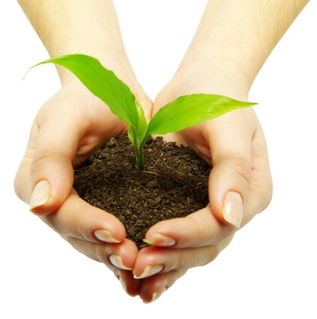
Building Happiness
Week 6
Committing to Growth, NOT Perfection
The purpose of this session is to:
  Identify the emotions, people, or situations where “stretching” builds happiness
  Understand the importance of growing and learning
  Explore the difficulties and unhappiness that can arise when we strive for perfection
Weekly Beginning Experience programme

Slide 13
Building Happiness
Week 6
Committing to Growth, NOT Perfection
At the end of the session, the participants are informed about a “Perfectionist Quiz”, they can take on line as a home exercise.
http://stress.about.com/library/perfectionism/bl_perfectionism_quiz.htm
Weekly Beginning Experience programme

Slide 14

Building Happiness
Week 7
Communication
The purpose of this session is to understand how different styles of communication can contribute to our happiness.
Creating a balance of
  Give and take
  Sharing and listening
Weekly Beginning Experience programme

Slide 15

Building Happiness
Week 8
Happiness and Spirituality
The purpose of this session is to understand how spirituality relates to our personal happiness.
Some ways to explore spirituality are provided
Given examples of mindfulness exercises they can do anytime in their lives
Weekly Beginning Experience programme

Slide 16

Building Happiness
Week 9
Describing Happy People
The purpose of this session is to understand that happiness comes largely from:
  How we live our lives
  The activities in which we decide to invest our hearts, minds, souls and strength
Weekly Beginning Experience programme

Slide 17

Building Happiness
Week 9
Happy People …
Are givers
Don’t wait for ‘someday’
Pursue goals
Are fully engaged
Connect with others
Have thankful hearts
Have boundaries
Don’t compare themselves to others
Find good in the world
Forgive
Weekly Beginning Experience programme

Slide 18

Building Happiness
Week 10
Celebrating Our Happiness
The purpose of this session is to review the concept that happiness comes from how we live our lives
Complete the course evaluation
Weekly Beginning Experience programme

Slide 19
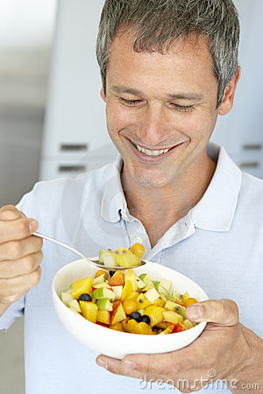
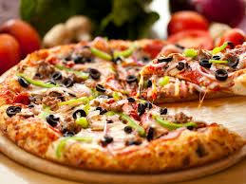
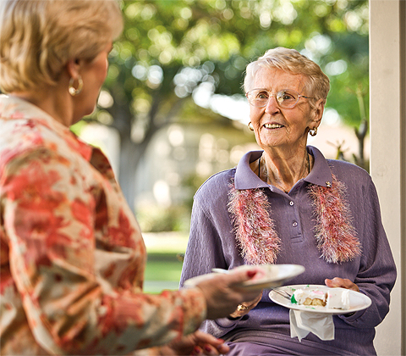
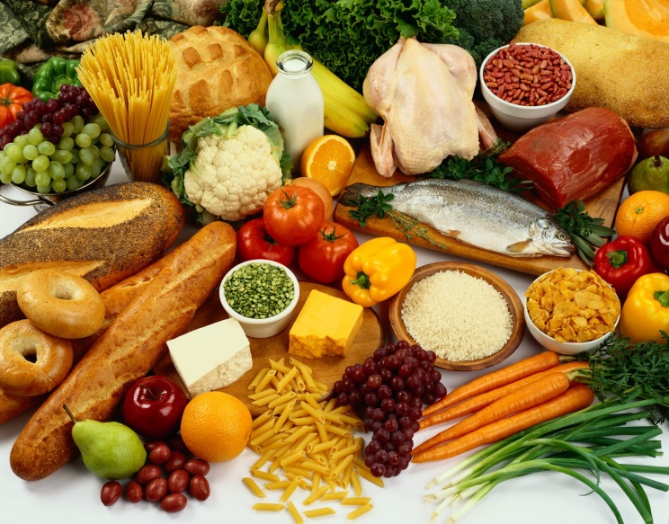
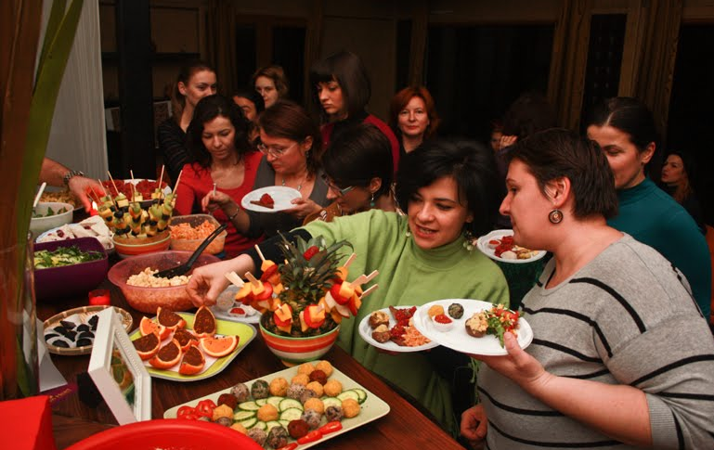
Building Happiness
Celebration Shared Lunch
Weekly Beginning Experience programme

Slide 20
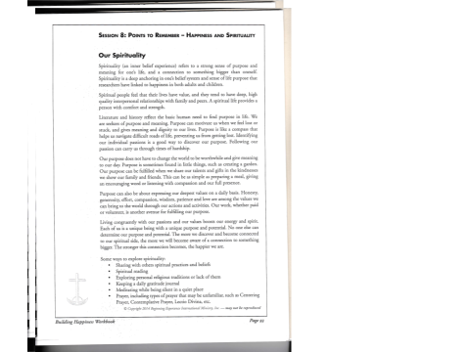

Slide 21
GENESIS 1:26
God said, “Let us make man in our own image, in the likeness of ourselves, and let them be masters of the fish of the sea, the birds of heaven, the cattle, all the wild animals and all the creatures that creep along the ground.”

Slide 22
Name two of your passions and two of your values.
In what ways do you act consistently with your passions and values (your purpose) day to day?
In what further ways could you behave consistently with your purpose?
Name ways you have or could further explore your spirituality?
During stressful times, what sustains you (internally and externally), helps you survive and replenishes your personal strength?
6. Name three things you are grateful for.

Slide 23
Ag Críost an Síol - To Christ the Seed flower
Ag Críost an síol, ag Críost an fómhar; To Christ the seed, to Christ the crop,
in iothlainn Dé go dtugtar sinn. in barn of Christ may we be brought.
Ag Críost an mhuir, ag Críost an t-iasc; To Christ the sea, to Christ the fish,
líonta Dé go gcastar sinn. in nets of Christ may we be caught.
Ó fhás go haois, ó aois go bás, From growth to age, from age to death,
do dhá láimh, a Chríost, anall tharainn. Thy two arms here, O Christ, about us.
Ó bhás go críoch nach críoch ach athfhás, From death to end, not end but growth,
i bParthas na ngrás go rabhaimid. in blessed Paradise may we be.
Courtesy of: An Duanaire, 1981
Translated by Thomas Kinsella

